Slide 1

Realtime Collaboration and Handwriting-to-Text Conversion: Noteable
Jason Brooks, Yale University
Sandhya Kapoor, IBM

Slide 2


Speaker Backgrounds
Jason Brooks
Third-Year Undergrad, Yale University
Ex-MongoDB Software Engineer
http://linkedin.com/in/jasonbrooks2
http://github.com/jasonsbrooks
http://twitter.com/jasonsbrooks
Sandhya Kapoor
Architect at IBM, Specializing in Cloud Computing & Middleware Software
https://www.linkedin.com/in/sandhyakapoor
https://github.com/sandhya9
https://twitter.com/sandhyakapoor9

Slide 3
Roadmap
Background and Motivation
What is Notable about Noteable?
Architecture and Technology Stack
Production Environment
Live Demonstration
Q&A

Slide 4
Background & Motivation

Slide 5
Background and Motivation
PennApps Hackathon, Fall 2014
Evolution of note-taking – it’s now a digital experience
Typed notes
Tablets and smart-pens
Two main conclusions:
Digital note-taking is not for everyone
Note-taking is a collaborative experience

Slide 6
The Problems
How can we bring digital note-taking experience to those who prefer handwritten notes?
How can we incorporate real-time collaboration with note-taking experience?
How can we take this experience to a global scale?

Slide 7


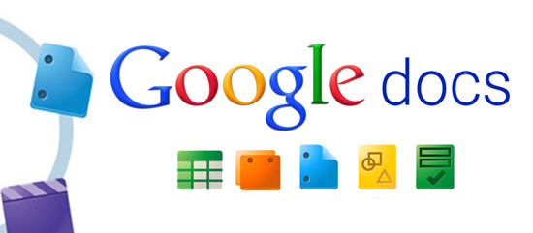

Products on the Market
Two main categories of products:
Searchable picture note applications
Collaborative note-taking applications

Slide 8
What is Notable about Noteable?

Slide 9
What is Noteable?
“Noteable is a cloud-based solution that reinvents the note-taking experience by fully digitizing handwritten notes and creating a medium for real-time collaboration using browsers/mobile devices across the globe”
Converting handwritten notes into fully digital/editable documents
On-the-fly sharing with instant access for collaborators
“Augmented Reality” extension to the note-taking experience

Slide 10
Two Methods | Pipeline
1) Existing Hand-Written Notes
2) On-the-fly collaborative note-taking
Take Picture with iPhone App and Upload
Image Pipeline Converts Picture into Digital Text
Image Pipeline Converts Picture into Digital Text
Send a Link to Collaborators to Open the Document
Sign into Noteable WebApp
Click to Instantly Create a New Document
Edits Will Show in Real Time As They are Made
Input a List of Email Addresses to Notify Collaborators

Slide 11
Benefits
Guaranteed scalability, reliability and failover with Bluemix
Only application that fuses together digitization of notes and real-time collaboration
Runnable across all platforms
Real-time, on-the-fly sharing

Slide 12
Walkthrough

Slide 13
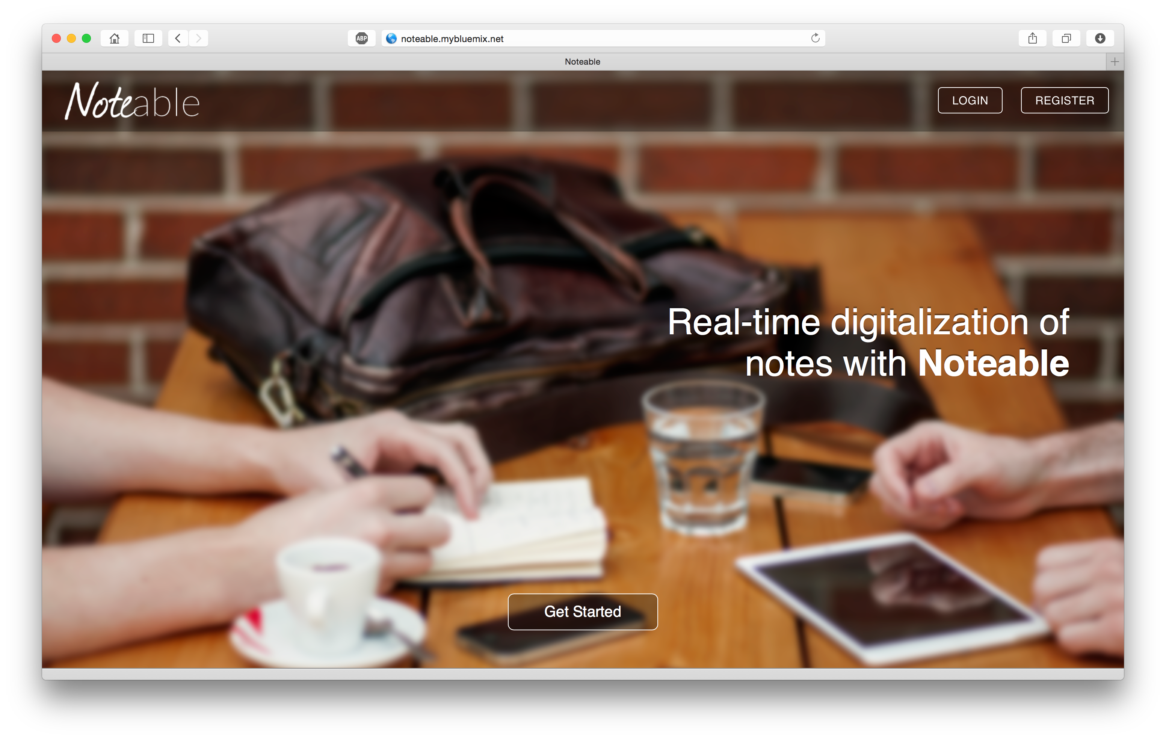
Web Application

Slide 14
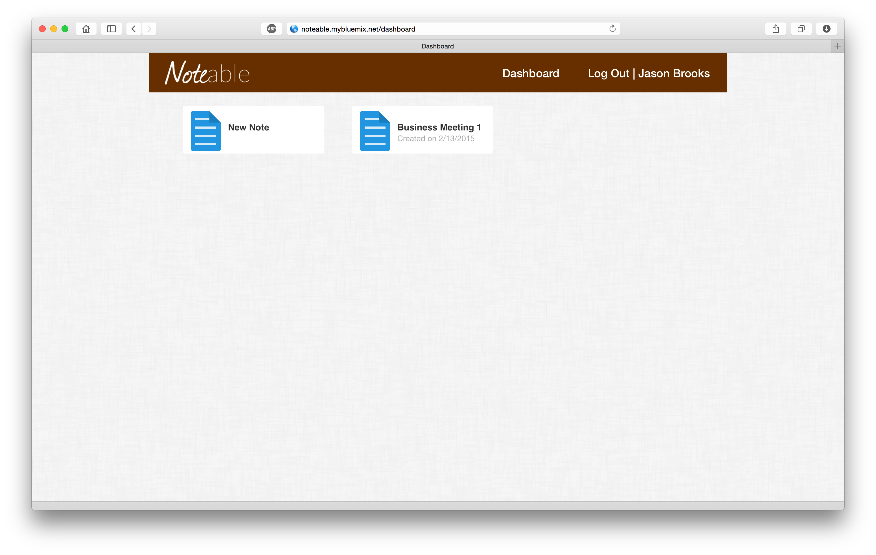
Web Application

Slide 15
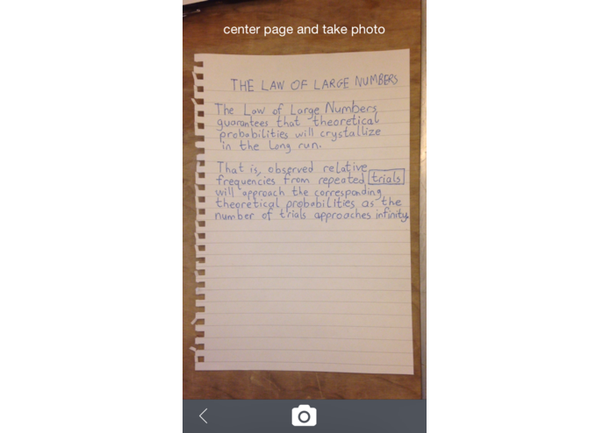
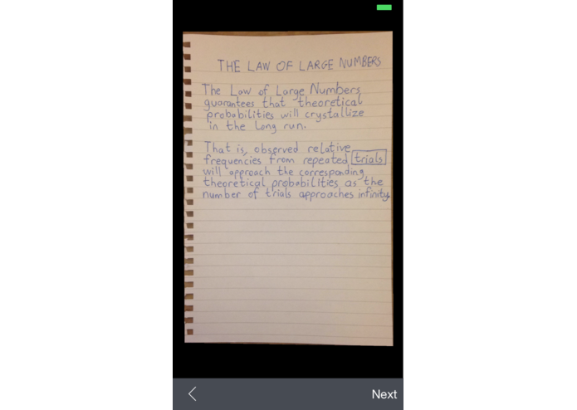
iPhone Application

Slide 16
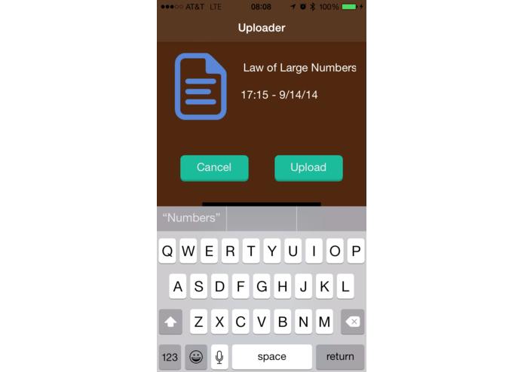
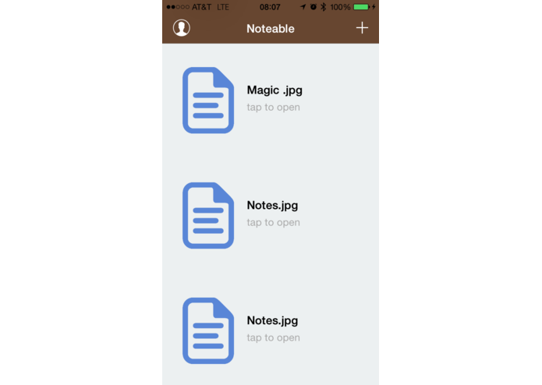
iPhone Application

Slide 17
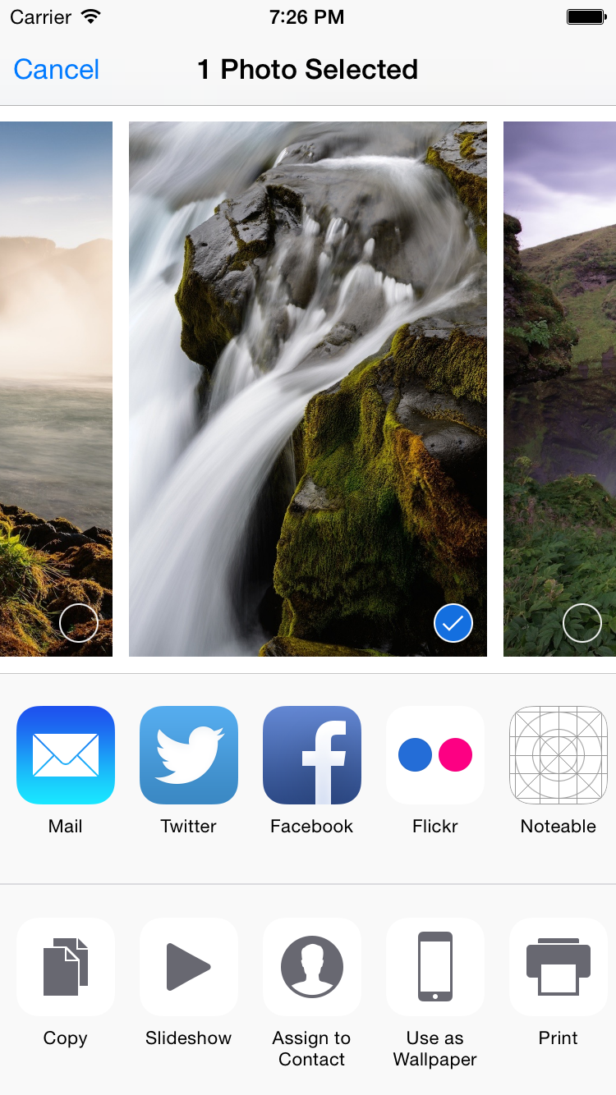

iPhone Sharing Extension
✔︎

Slide 18
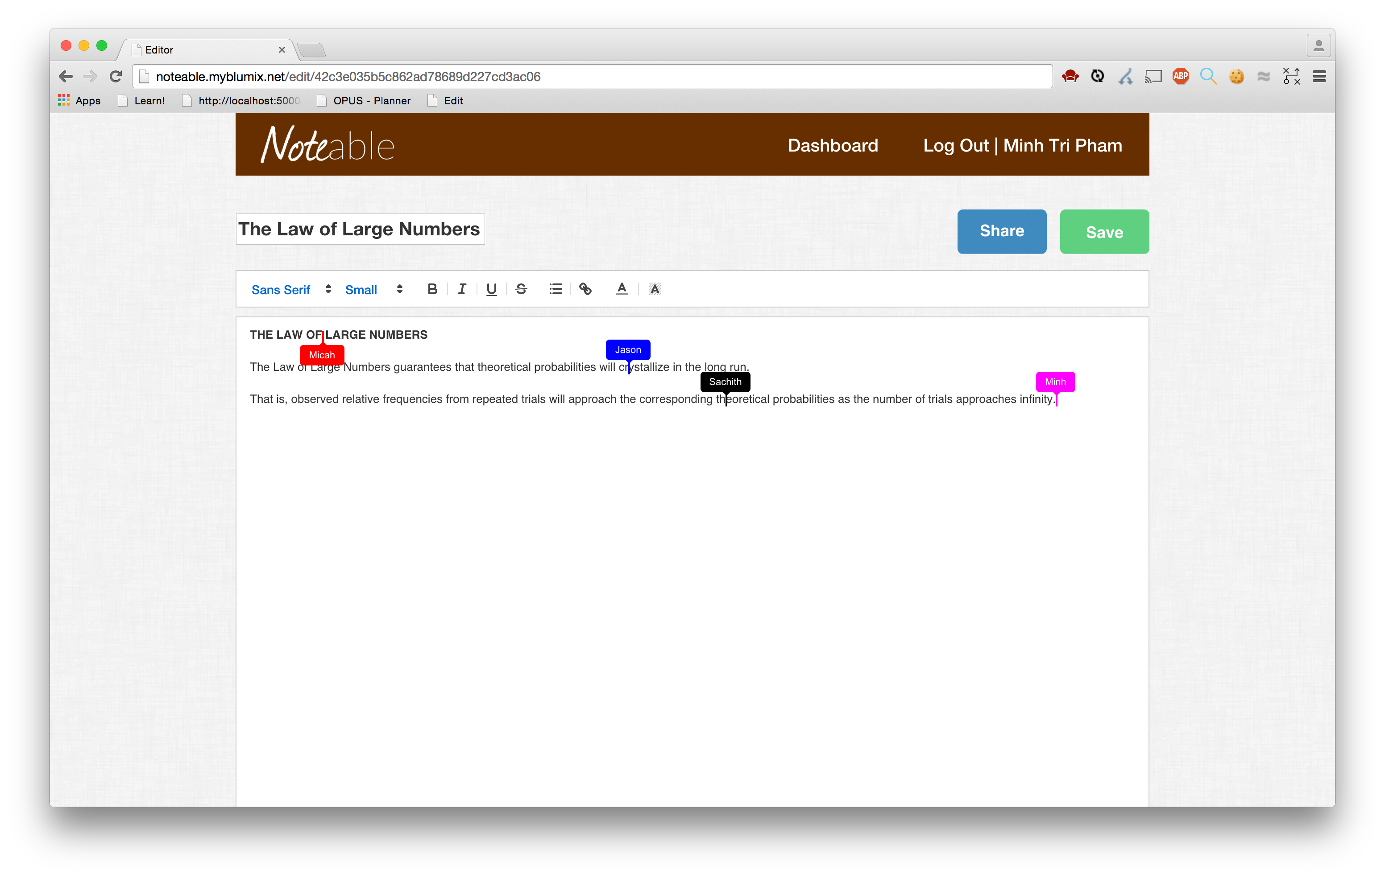
Collaborative Editing

Slide 19
Architecture and Technology Stack

Slide 20
Overview of Technology
Web:
“CANE” stack – Cloudant, Angular, Node.js, Express
Custom Python pipeline for image processing
Operational Transformation (OT) implementation for collaborative editing with ShareJS and Rich-Text OTType
iOS:
Objective-C application built in Xcode
iOS extension for uploading capability
Android:
Java application built in Android Studio
Android SDK for uploading capability

Slide 21
Data Pipeline
Web Application
Front End
node.js web server
Cloudant
iOS/Android Application

Slide 22
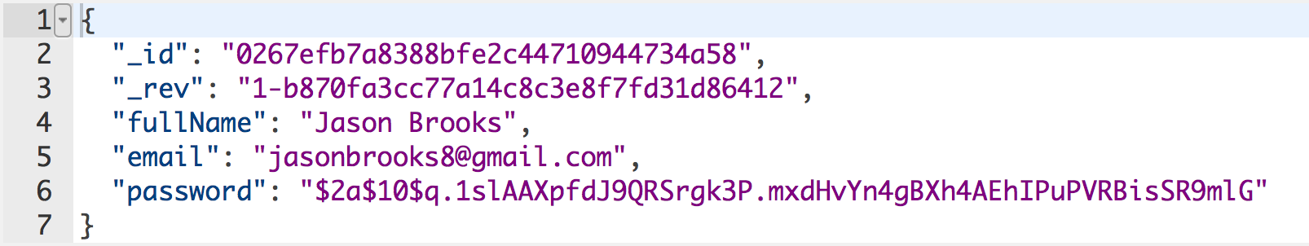
User Objects with Cloudant

Slide 23
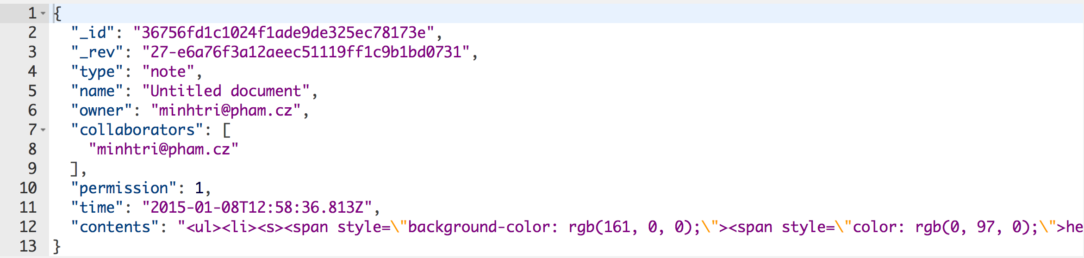
Note Objects with Cloudant

Slide 24
Image Processing Pipeline
iPhone App
Python Server
Extract Note Page from Image with iOS OpenCV Library
Custom OCR Implementation Built on Tesseract
Send Enhanced Note Image with Metadata to Server
Augmented Reality with AlchemyAPI

Slide 25
Collaborative Editing
node.js Server
Web Front-End
ShareJS
Sockets.IO
LiveDB with Custom
Cloudant Wrapper
QuillJS

Slide 26
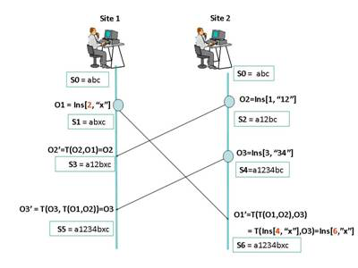
Operational Transformation

Slide 27
Production Environment

Slide 28
Production Environment
App lives on IBM Bluemix
Guaranteed scalability of application
Utilizes auto scaling add-on
Usage goes above/below a certain amount, another instance will be spawned/removed
Guaranteed reliability of application
Linux containers detect when app goes down & create another instance
Guaranteed security of application
Platform security via DataPower appliance
Application security via SSO &SSL

Slide 29
DevOps Tools
Git integration with IBM Bluemix for pushing changes
Default node.js runtime
Intuitive logging on Bluemix for error debugging
Easy integration and real-time data viewing with Cloudant

Slide 30
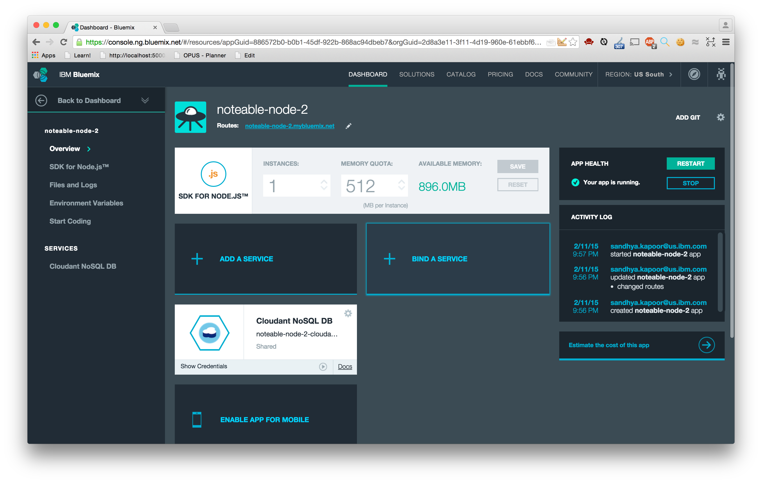
Bluemix Environment

Slide 31
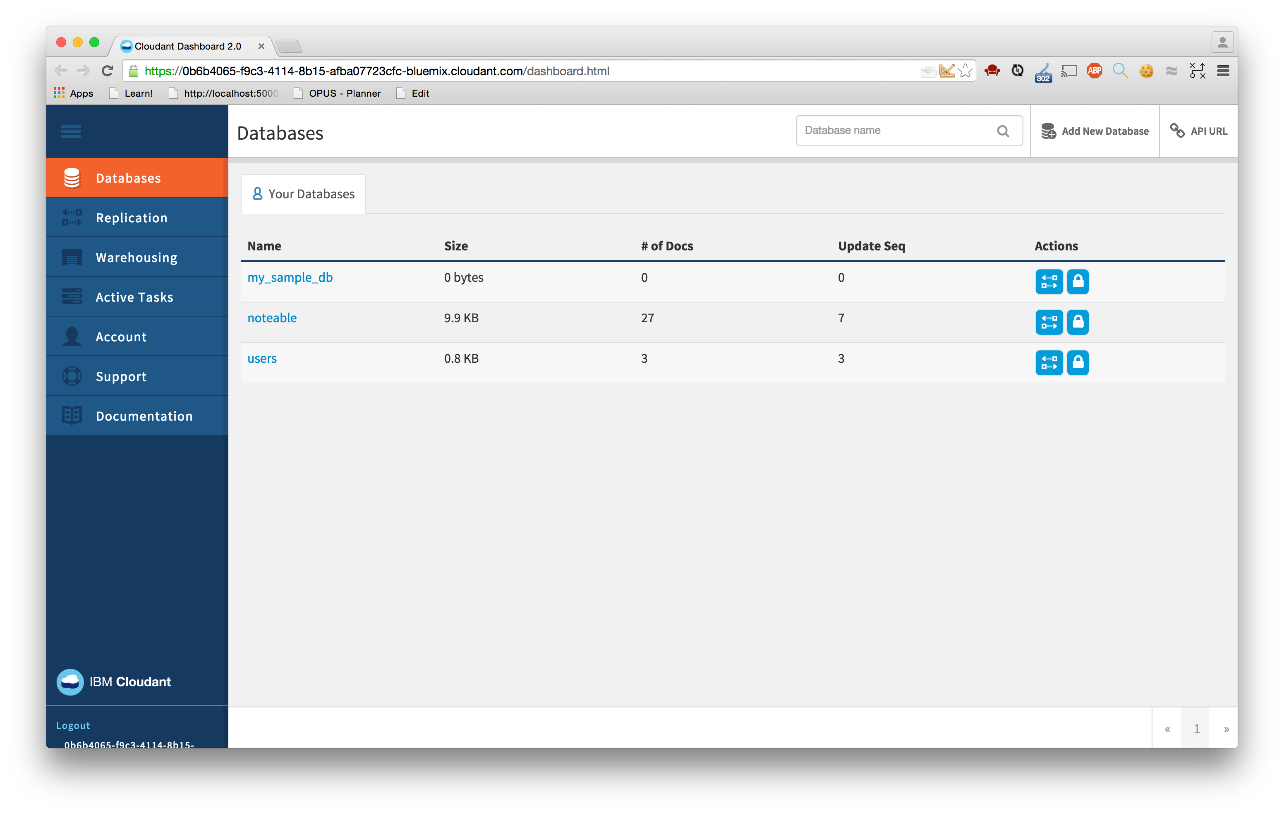
Cloudant Environment

Slide 32
Demo Video

Slide 33
Q&A

Slide 34
Notices and Disclaimers
Copyright © 2015 by International Business Machines Corporation (IBM). No part of this document may be reproduced or transmitted in any form without written permission from IBM.
U.S. Government Users Restricted Rights - Use, duplication or disclosure restricted by GSA ADP Schedule Contract with IBM.
Information in these presentations (including information relating to products that have not yet been announced by IBM) has been reviewed for accuracy as of the date of initial publication and could include unintentional technical or typographical errors. IBM shall have no responsibility to update this information. THIS DOCUMENT IS DISTRIBUTED "AS IS" WITHOUT ANY WARRANTY, EITHER EXPRESS OR IMPLIED. IN NO EVENT SHALL IBM BE LIABLE FOR ANY DAMAGE ARISING FROM THE USE OF THIS INFORMATION, INCLUDING BUT NOT LIMITED TO, LOSS OF DATA, BUSINESS INTERRUPTION, LOSS OF PROFIT OR LOSS OF OPPORTUNITY. IBM products and services are warranted according to the terms and conditions of the agreements under which they are provided.
Any statements regarding IBM's future direction, intent or product plans are subject to change or withdrawal without notice.
Performance data contained herein was generally obtained in a controlled, isolated environments. Customer examples are presented as illustrations of how those customers have used IBM products and the results they may have achieved. Actual performance, cost, savings or other results in other operating environments may vary.
References in this document to IBM products, programs, or services does not imply that IBM intends to make such products, programs or services available in all countries in which IBM operates or does business.
Workshops, sessions and associated materials may have been prepared by independent session speakers, and do not necessarily reflect the views of IBM. All materials and discussions are provided for informational purposes only, and are neither intended to, nor shall constitute legal or other guidance or advice to any individual participant or their specific situation.
It is the customer’s responsibility to insure its own compliance with legal requirements and to obtain advice of competent legal counsel as to the identification and interpretation of any relevant laws and regulatory requirements that may affect the customer’s business and any actions the customer may need to take to comply with such laws. IBM does not provide legal advice or represent or warrant that its services or products will ensure that the customer is in compliance with any law.

Slide 35
Notices and Disclaimers (con’t)
Information concerning non-IBM products was obtained from the suppliers of those products, their published announcements or other publicly available sources. IBM has not tested those products in connection with this publication and cannot confirm the accuracy of performance, compatibility or any other claims related to non-IBM products. Questions on the capabilities of non-IBM products should be addressed to the suppliers of those products. IBM does not warrant the quality of any third-party products, or the ability of any such third-party products to interoperate with IBM’s products. IBM EXPRESSLY DISCLAIMS ALL WARRANTIES, EXPRESSED OR IMPLIED, INCLUDING BUT NOT LIMITED TO, THE IMPLIED WARRANTIES OF MERCHANTABILITY AND FITNESS FOR A PARTICULAR PURPOSE.
The provision of the information contained herein is not intended to, and does not, grant any right or license under any IBM patents, copyrights, trademarks or other intellectual property right.
IBM, the IBM logo, ibm.com, Bluemix, Blueworks Live, CICS, Clearcase, DOORS®, Enterprise Document Management System™, Global Business Services ®, Global Technology Services ®, Information on Demand, ILOG, Maximo®, MQIntegrator®, MQSeries®, Netcool®, OMEGAMON, OpenPower, PureAnalytics™, PureApplication®, pureCluster™, PureCoverage®, PureData®, PureExperience®, PureFlex®, pureQuery®, pureScale®, PureSystems®, QRadar®, Rational®, Rhapsody®, SoDA, SPSS, StoredIQ, Tivoli®, Trusteer®, urban{code}®, Watson, WebSphere®, Worklight®, X-Force® and System z® Z/OS, are trademarks of International Business Machines Corporation, registered in many jurisdictions worldwide. Other product and service names might be trademarks of IBM or other companies. A current list of IBM trademarks is available on the Web at "Copyright and trademark information" at: www.ibm.com/legal/copytrade.shtml.

Slide 36
Thank You
Your Feedback is Important!
Access the InterConnect 2015 Conference CONNECT Attendee Portal to complete your session surveys from your smartphone,
laptop or conference kiosk.

